Slide 1
C
Functions

Slide 2
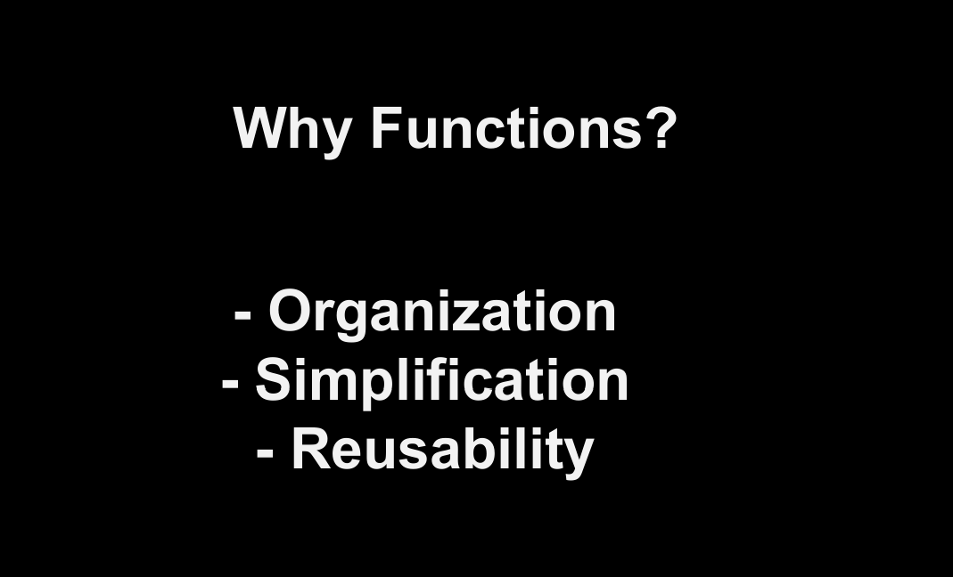
C Header Files
<assert.h> Program assertion functions
<ctype.h> Character type functions
<locale.h> Localization functions
<math.h> Mathematics functions
<setjmp.h> Jump functions
<signal.h> Signal handling functions
<stdarg.h> Variable arguments handling functions
<stdio.h> Standard Input/Output functions
<stdlib.h> Standard Utility functions
<string.h> String handling functions
<time.h> Date time functions
How it works?
Library Functions in Different Header Files

Slide 3
C
Standard library functions

Slide 4
printf();
scanf();
puts();
putc();
fgets();
.
.
.
.
stdio functions
The standard library functions are built-in functions in C programming.

Slide 5
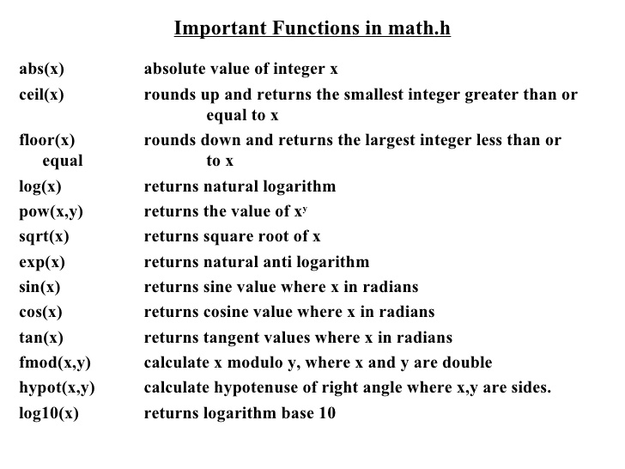
counter = counter + 1

Slide 6
math.h
Example 3.1
library functions

Slide 7
C Header Files
<assert.h> Program assertion functions
<ctype.h> Character type functions
<locale.h> Localization functions
<math.h> Mathematics functions
<setjmp.h> Jump functions
<signal.h> Signal handling functions
<stdarg.h> Variable arguments handling functions
<stdio.h> Standard Input/Output functions
<stdlib.h> Standard Utility functions
<string.h> String handling functions
<time.h> Date time functions
<assert.h> | Program assertion functions
<ctype.h> | Character type functions
<math.h> | Mathematics functions
<signal.h> | Signal handling functions
<stdlib.h> | Standard Utility functions
<string.h> | String handling functions
<time.h> | Date time functions
Header files
Library Functions in Different Header Files

Slide 8
C
User-defined function

Slide 9
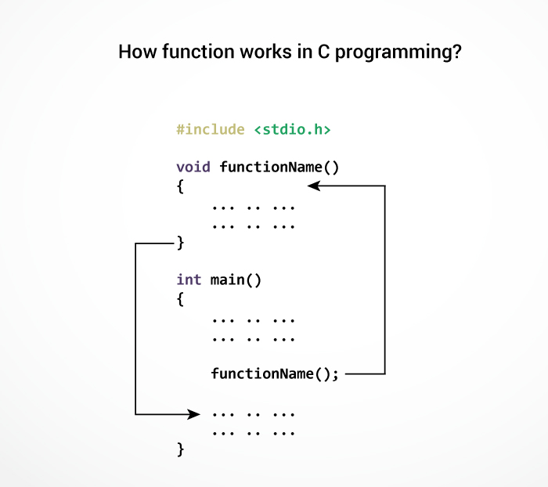
C
User-defined function

Slide 10
return_t function(parameters)
{
body of the function
}
definition
function definition

Slide 11
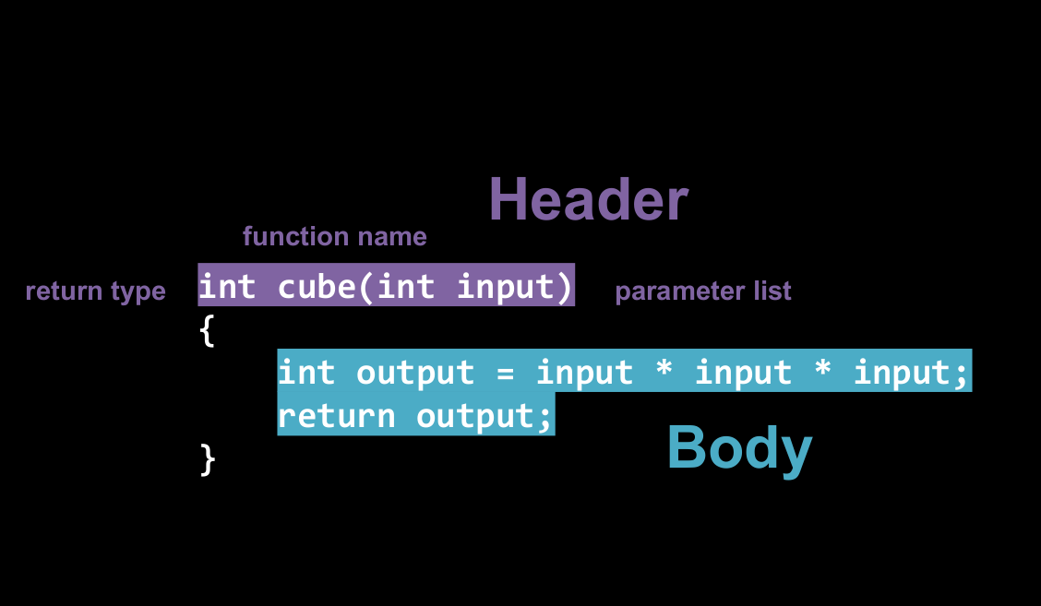
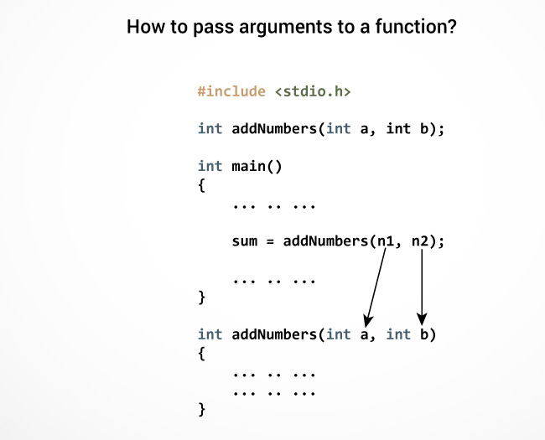
if (test expression) {
// statements to be executed if the test expression is true
}
else {
// statements to be executed if the test expression is false
}
if .. else statement
The if statement may have an optional else block.

Slide 12
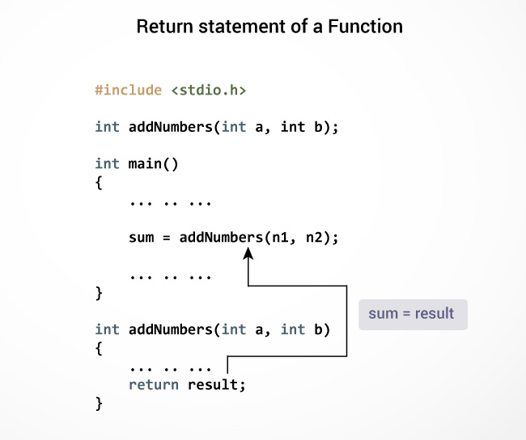
if (test expression) {
// statements to be executed if the test expression is true
}
else {
// statements to be executed if the test expression is false
}
if .. else statement
The if statement may have an optional else block.

Slide 13
User-defined function
Example 3.2
example

Slide 14
Types of User-defined Functions in C
Example 3.3
3.6

Slide 15
Questions?

Slide 16
*Fact*
What do you know about Qalb? http://nas.sr/---/

Slide 17
C
Recursion

Slide 18
Google It
Recursion

Slide 19
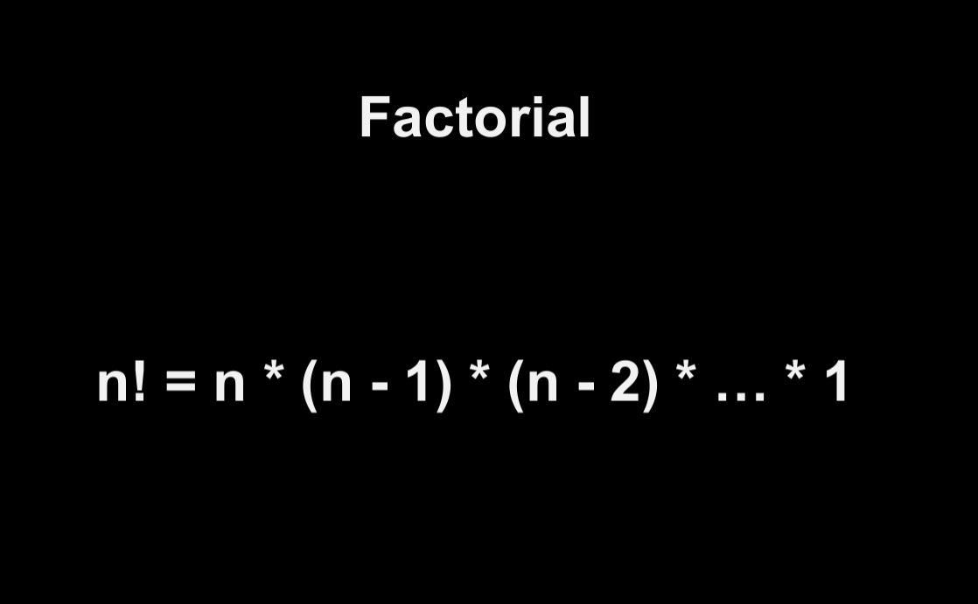
C
Recursion

Slide 20
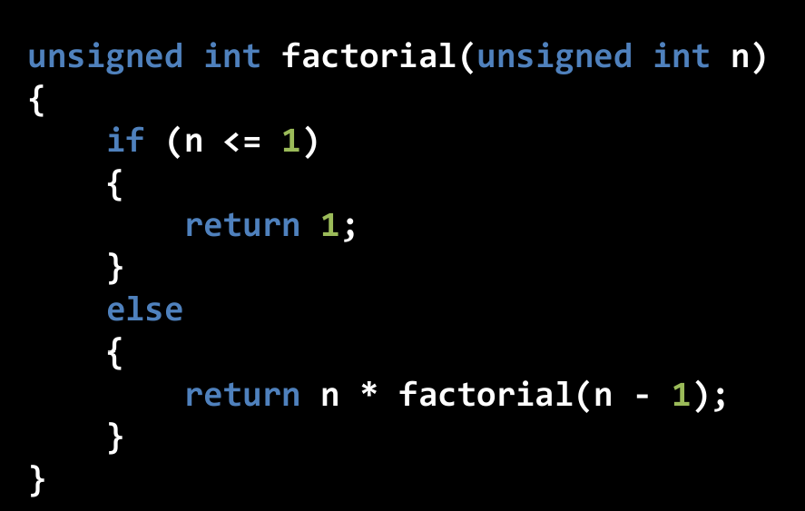
C
Recursion

Slide 21
C
Recursion

Slide 22
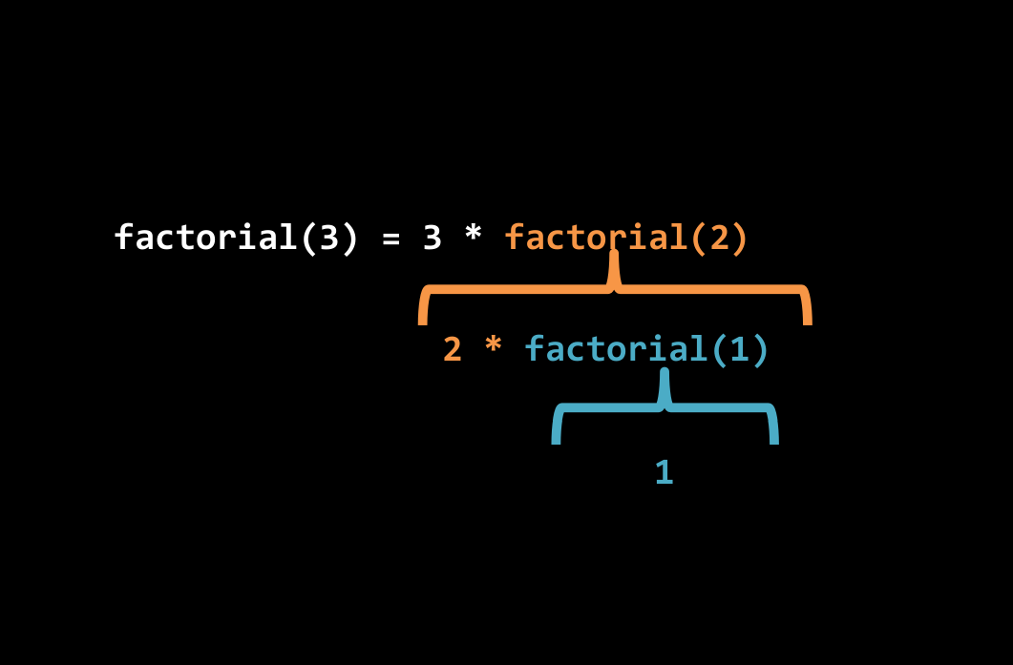
C
Recursion

Slide 23
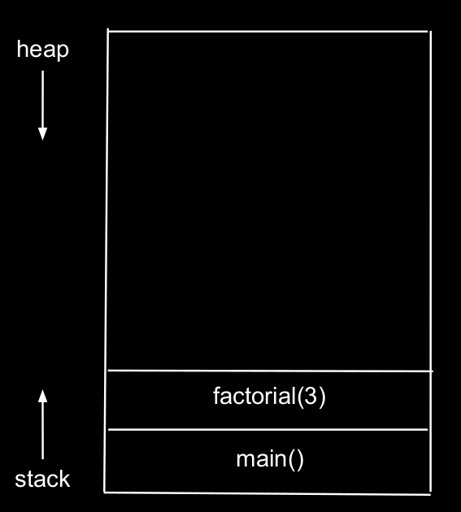
C
Recursion

Slide 24
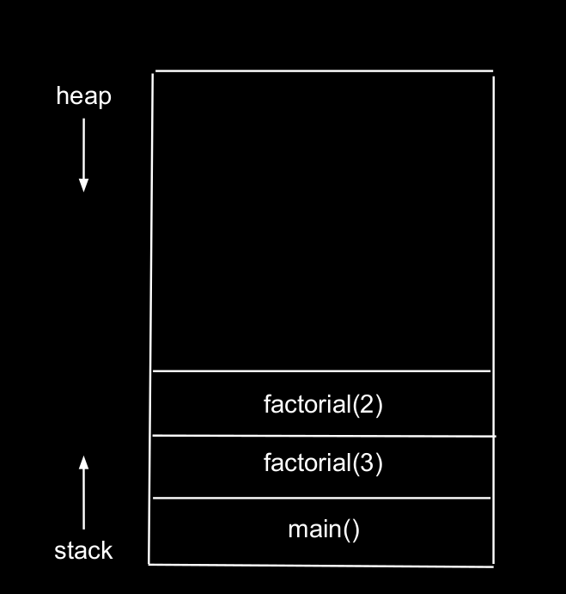
C
Recursion

Slide 25
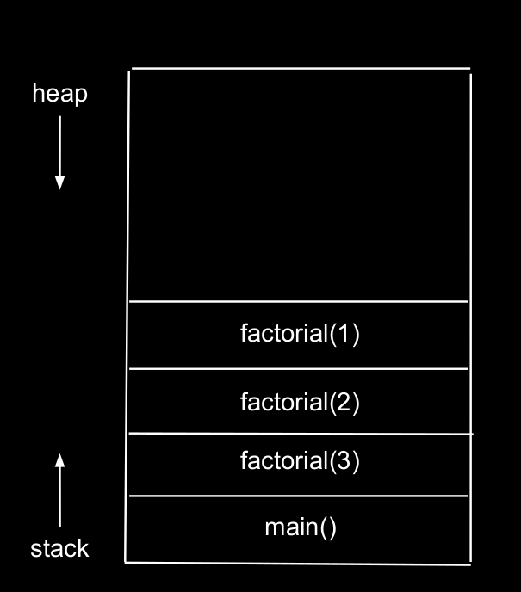
C
Recursion

Slide 26
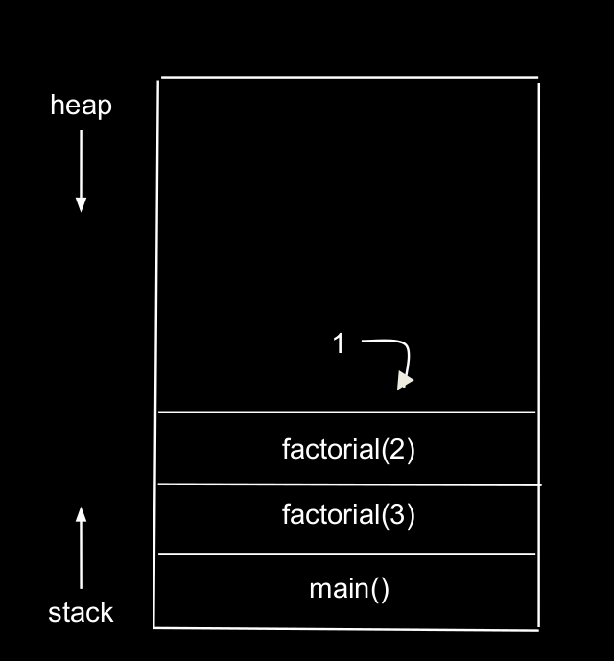
C
Recursion

Slide 27
C
Recursion

Slide 28
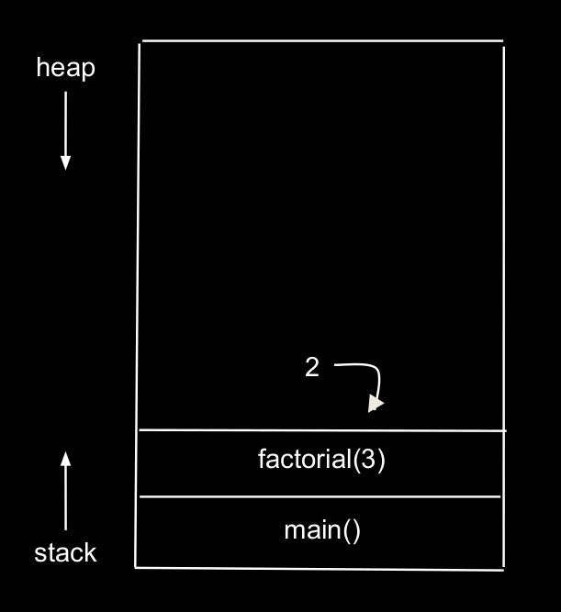
C
Recursion

Slide 29
C
Recursion

Slide 30
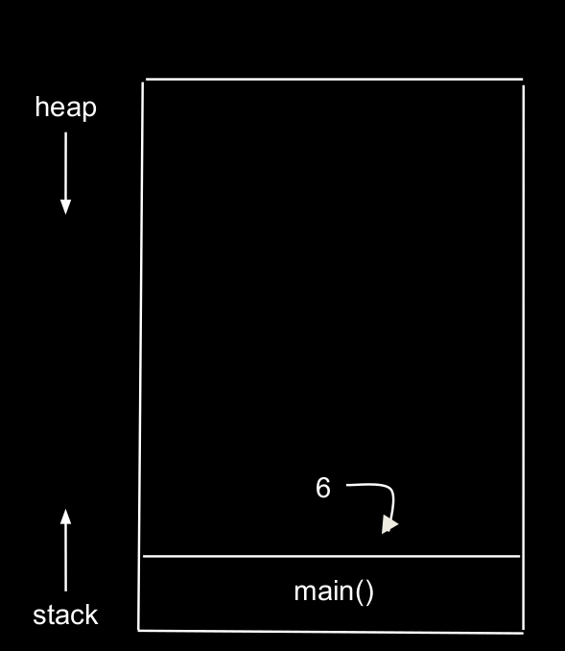
C
Recursion

Slide 31
Questions?

Slide 32
*Fact*
What do you know about Ook?

Slide 33
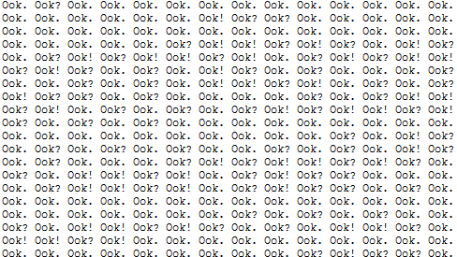

Slide 34


Slide 35
YOU CAN DO IT!
GUESS GAME!

Slide 36
YOU CAN DO IT!
Geo with Checker
http://bit.ly/2lzpU22

